Slide 1
Impact of high-school neighborhood business environment in Public Education
Surendra Prajapat

Slide 2
Comparing Top High School Performance in two US states
Pick two US states having similar economic data (New Jersey and Ohio picked).
Pick Top High-School based on US-News report.
Collect School Report from State’s Department of Education.
Analyze school performance on
English, Language, Art (ELA)
Math
College enrollment rate
Absenteeism

Slide 3
Data Sources
State’s Department of Education
New Jersey
https://rc.doe.state.nj.us/runreport.aspx?type=school&school=010&district=3260&county=25&year=2017-2018
https://rc.doe.state.nj.us/SearchForSchool.aspx
Ohio
http://education.ohio.gov/lists_and_rankings
http://education.ohio.gov/Topics/Data/Report-Card-Resources
https://reportcard.education.ohio.gov/school/prepared/039073
US-News
https://www.usnews.com/education/best-high-schools/new-jersey
https://www.usnews.com/education/best-high-schools/ohio
US Bureau of Economic Analysis
https://www.bea.gov/system/files/2018-12/spi1218.pdf.

Slide 4
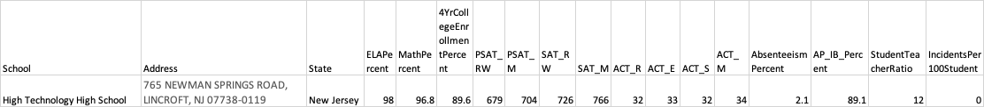
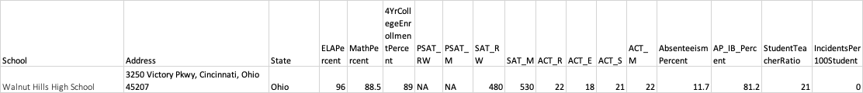
Top High Schools
New Jersey
High Technology High School, 765 NEWMAN SPRINGS ROAD, LINCROFT, NJ 07738-0119
Ohio
Walnut Hills High School, 3250 Victory Pkwy, Cincinnati, Ohio 45207

Slide 5
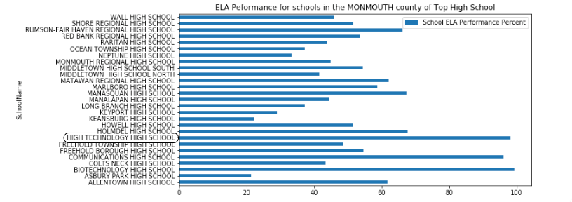
New Jersey - High Technology High School – ELA Performance

Slide 6
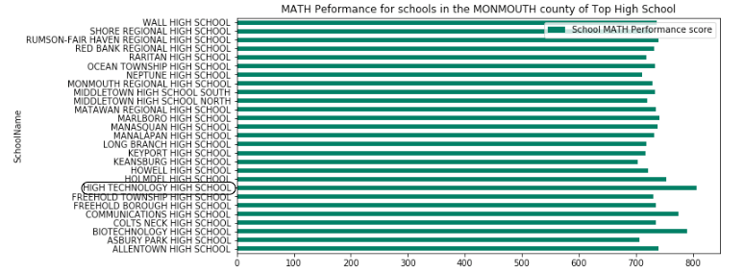
New Jersey - High Technology High School – MATH Performance

Slide 7
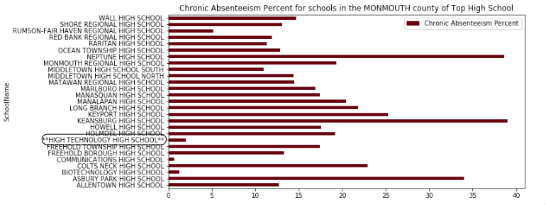
New Jersey - High Technology High School – Absenteeism Rate

Slide 8
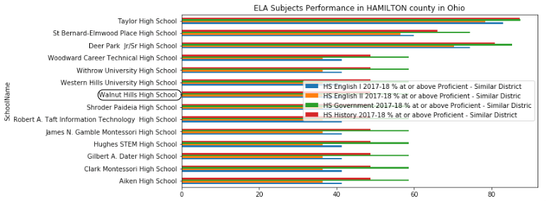
OHIO - Walnut Hills High School ELA Performance

Slide 9
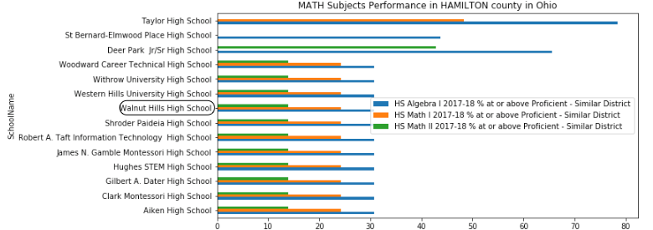
OHIO - Walnut Hills High School MATH Performance

Slide 10
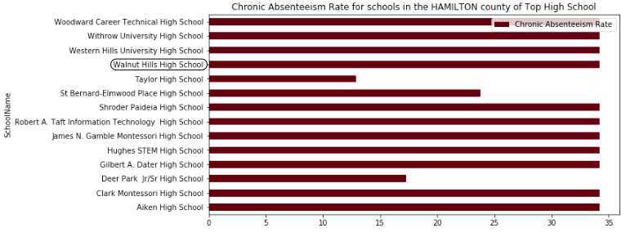
OHIO - Walnut Hills High School Absenteeism Rate

Slide 11
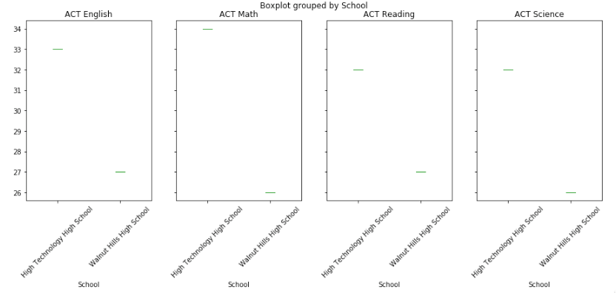
Comparing School Stats - ACT

Slide 12
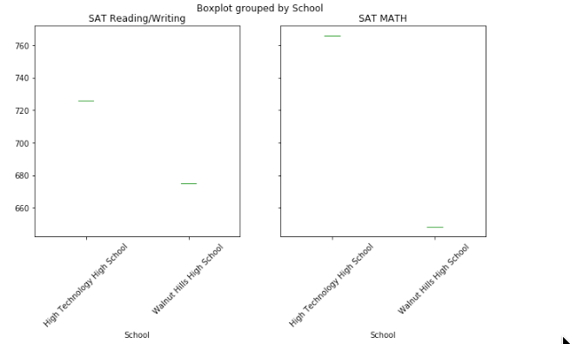
Comparing School Stats - SAT

Slide 13
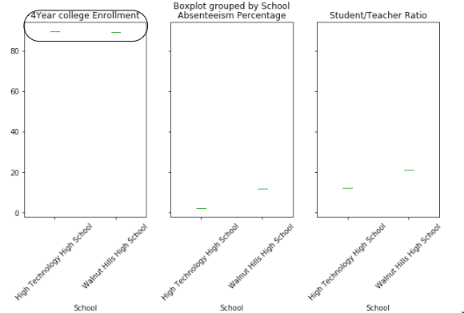
Comparing School Stats – Other factors

Slide 14
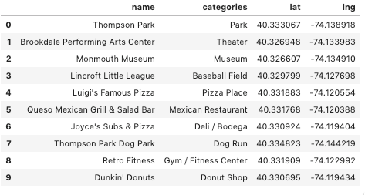
New Jersey - High Technology High School – Top 10 venues in 1-Mile Radius

Slide 15
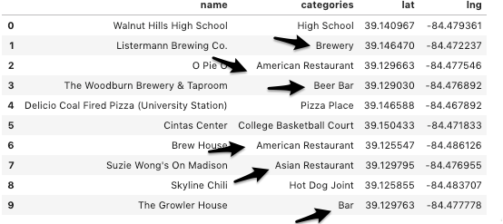
OHIO - Walnut Hills High School– Top 10 venues in 1-Mile Radius

Slide 16
Conclusion – Impact of Environment
Environment seems to play role in poor student performance.
Ohio Top High School has more distractions in 1-mile radius
There are 3 Brewery/Bar. 3 Restaurants, 2 fast-food places
Absenteeism rate is very high
STEM course performance is low
New Jersey Top High School has very little distractions in 1-mile radius
There is no Bar or Brewery. Only one restaurant and 2 fast-food places
ACT/SAT performance is high
Absenteeism rate is very low
STEM course performance is high

Slide 17
Thanks

